Slide 1


Transformers

Slide 2
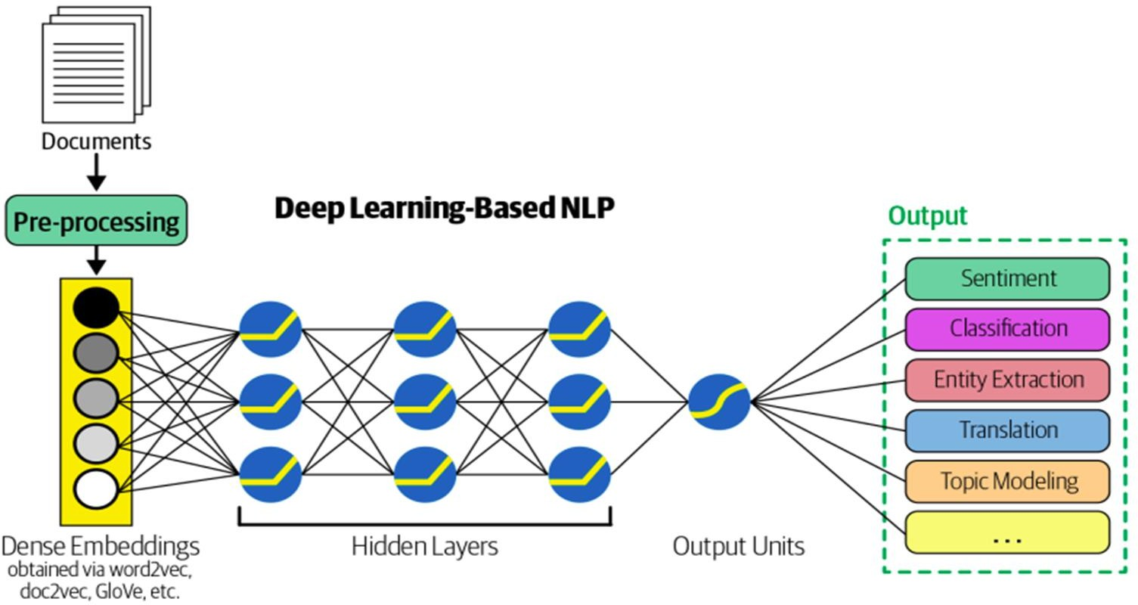
Deep Learning-Based NLP

Slide 3
Word Embedding
Word embedding is a technique used in NLP to represent words as
numerical vectors in a high-dimensional space.
Word embedding aims to capture the meaning and context of words in a way that is useful for downstream NLP tasks, such as text classification, sentiment analysis, and machine translation.
There are several popular algorithms for creating word embeddings, such as Word2Vec, GloVe, and fastText.

Slide 4
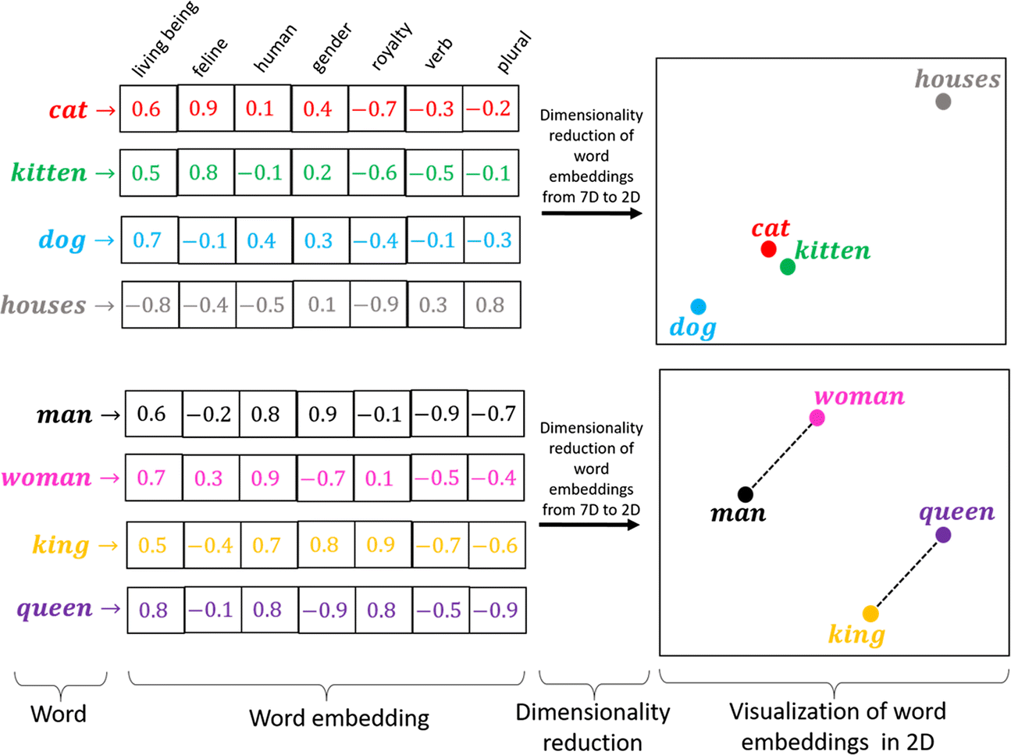
Word Embedding

Slide 5
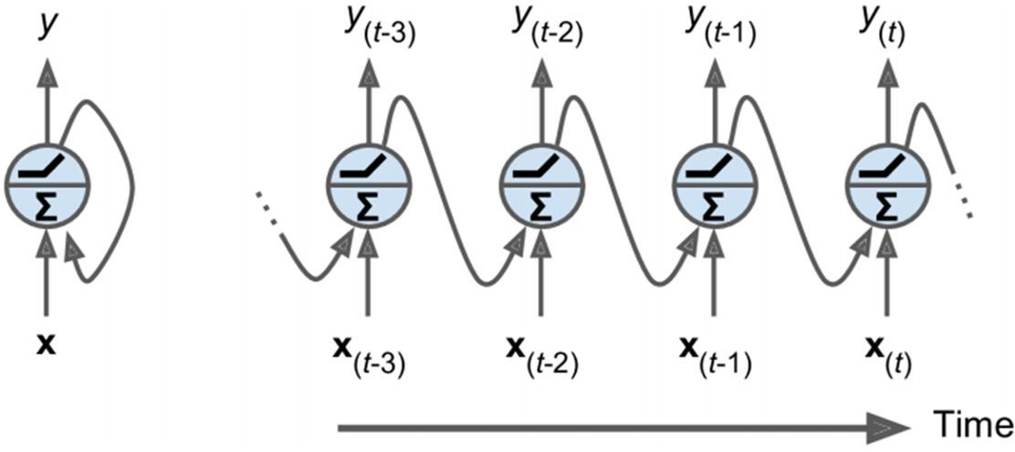
Recurrent Neural Network(RNN)
The simplest possible RNN composed of one neuron receiving inputs, producing an output, and sending that output back to itself (figure -left).
We can represent this tiny network against the time axis, as shown in (figure - right). This is called unrolling the network through time.

Slide 6
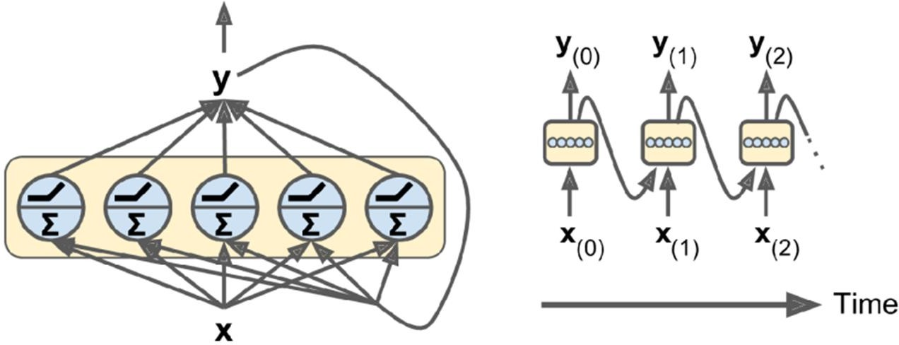
Recurrent Neural Network(RNN)
You can easily create a layer of recurrent neurons. At each time step t, every neuron receives both the input vector x(t) and the output vector from the previous time step y(t–1).
A recurrent neuron (left) unrolled through time (right)

Slide 7
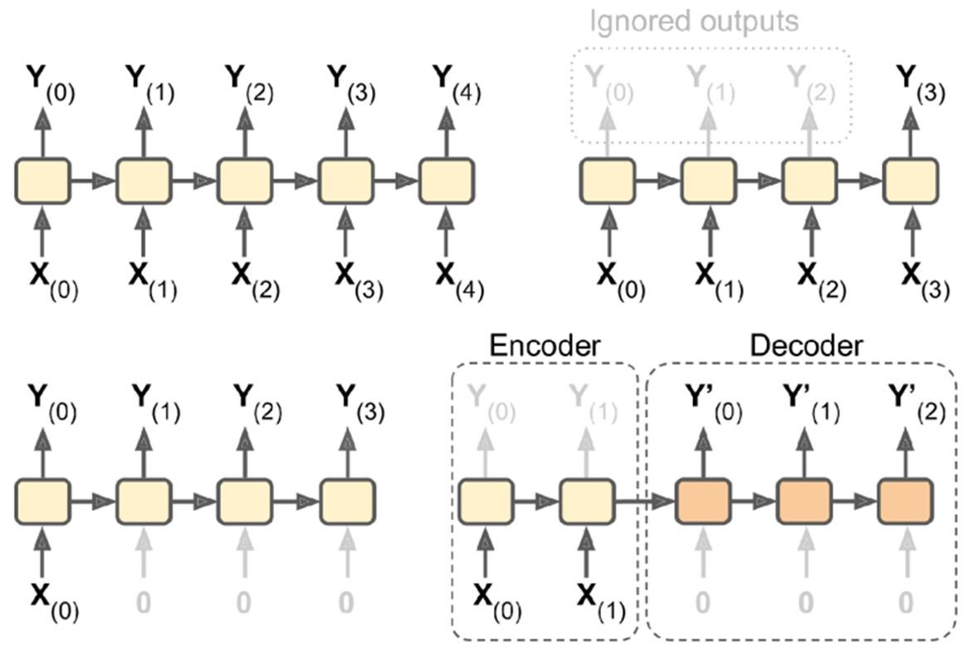
Recurrent Neural Network(RNN)
Seq-to-seq (top left), seq-to-vector (top right), vector-to-seq (bottom left), and Encoder–Decoder (bottom right) networks.

Slide 8
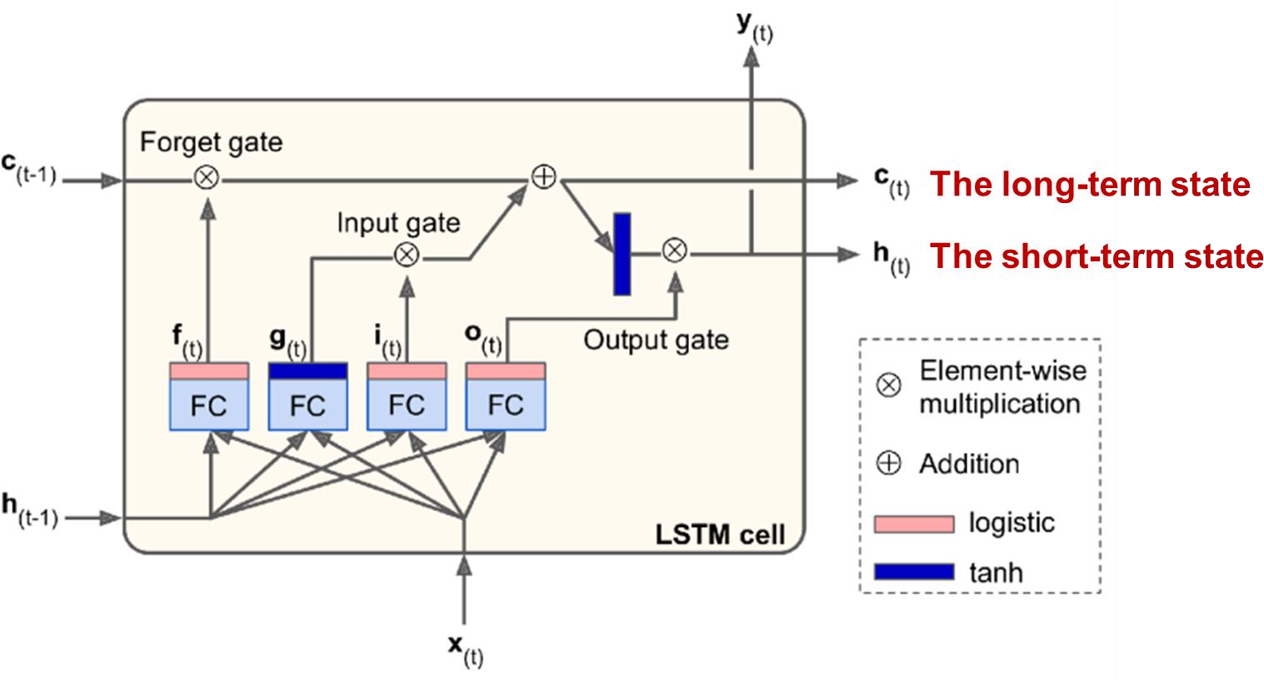
Long Short-Term Memory (LSTM)
When the data traversing an RNN, some information is lost at each time step. After a while, the RNN’s state contains virtually no trace of the first inputs.

Slide 9
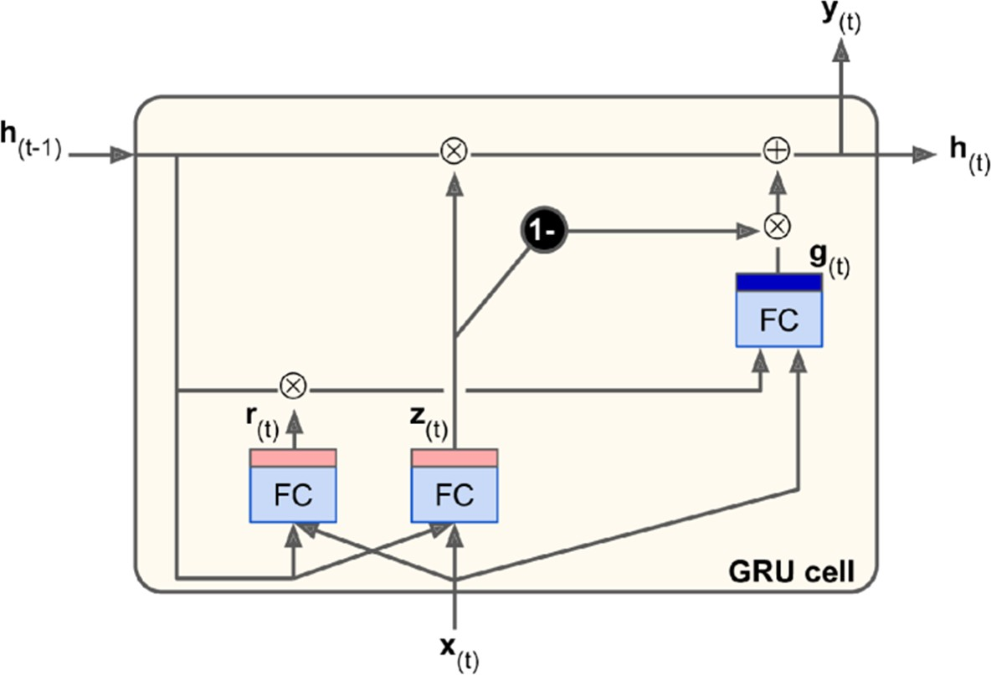
Gated Recurrent Unit (GRU)

Slide 10
Gated Recurrent Unit (GRU)
uses LSTM architecture by merging its gating mechanisms offering a more efficient solution for many sequential tasks
use gating mechanisms to selectively update the hidden state at each time step allowing them to remember important information while discarding irrelevant details.
focus on just two main gates: the update gate and the reset gate.

Slide 11
Update Gate (z_{t}): This gate decides how much information from previous hidden state should be retained for the next time step.
Reset Gate (r_{t}​​): This gate determines how much of the past hidden state should be forgotten.

Slide 12
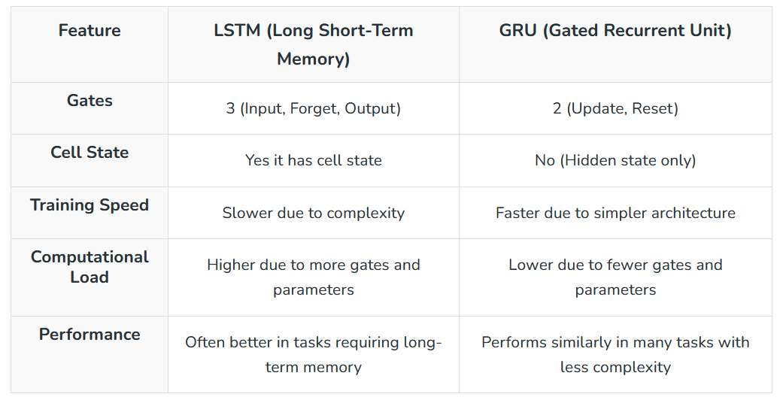
LSTM Vs GRU

Slide 13
Bidirectional RNNs
For example: in Neural Machine Translation, it is often preferable to look ahead at the next words before encoding a given word.
Consider the phrases "the queen of the United Kingdom", "the queen of hearts", and "the queen bee": to properly encode the word “queen”, you need to look ahead.

Slide 14
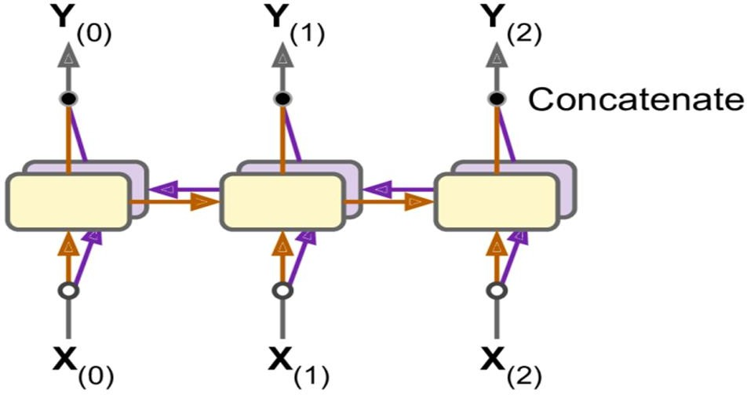
Bidirectional RNNs
To implement this, run two recurrent layers on the same inputs, one reading the words from left to right and the other reading them from right to left. Then simply concatenating them.

Slide 15
Self-Attention

Slide 16
Self-Attention
The following sentence is an input sentence we want to translate: "The animal didn't cross the street because it was too tired“
What does "it" in this sentence refer to?
Is it referring to the street or to the animal? It’s a simple question to a human but not as simple to an algorithm.
When the model is processing the word "it", self-attention allows it to associate "it" with "animal".

Slide 17
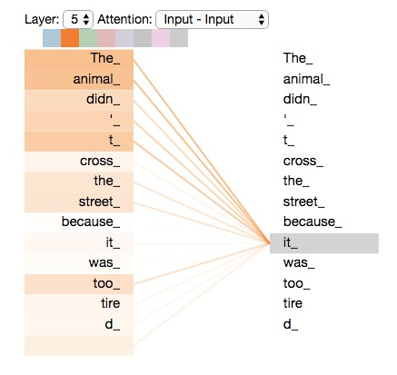
Self-Attention
As we are encoding the word "it" in encoder #5 (the top encoder in the stack), part of the attention mechanism was focusing on "The Animal", and baked a part of its representation into the encoding of "it".

Slide 18
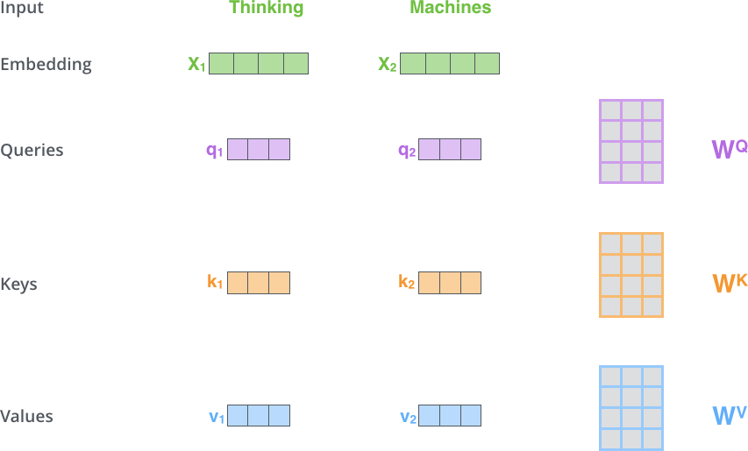
Self-Attention in Detail
Weights
Multiplying x1 by the WQ weight matrix produces q1, the "query" vector associated with that word. We end up creating a "query", a "key", and a "value" projection of each word in the input sentence.

Slide 19
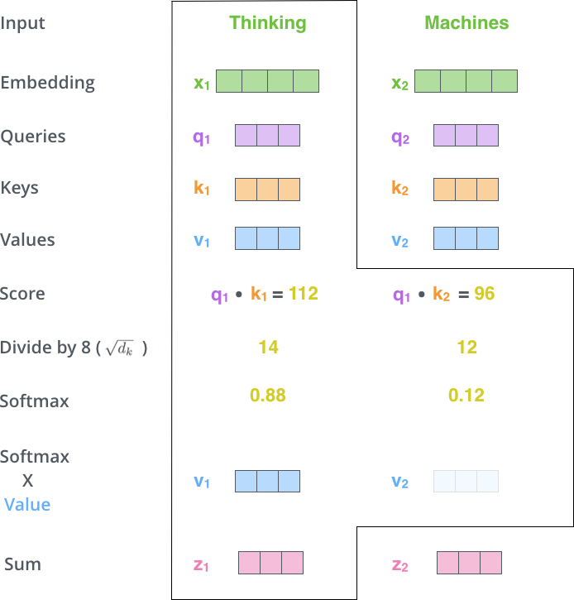
Self-Attention in Detail
dot product

Slide 20
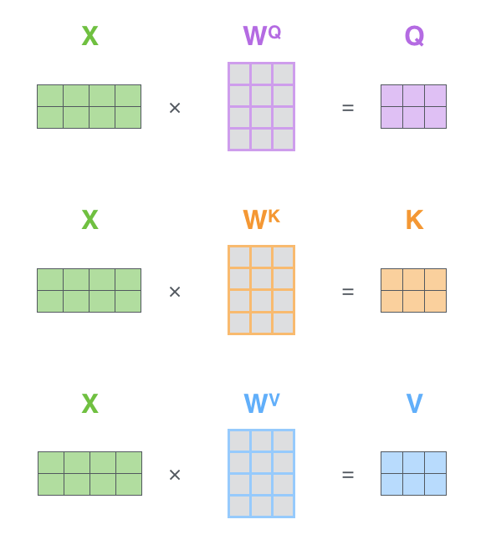
Matrix Calculation of Self-Attention
Every row in the X matrix corresponds to a word in the input sentence.

Slide 21
worked example 1
“I love NLP”
x_{1​}=I, x_{2​}=love, x_{3​}=NLP
Compute:
self-attention for the word “love”
Step 1: Token Embeddings (Given)
d_{model}=2 (dimensionality)
Word | Embedding
I | [1, 0]
love | [0, 1]
NLP | [1, 1]

Slide 22
Step 2: Weight Matrices (Given)
Step 3: Compute Query, Key, Value

Slide 23
Step 4: Compute Attention Scores (QKᵀ)
Step 5: Scale the Scores

Slide 24
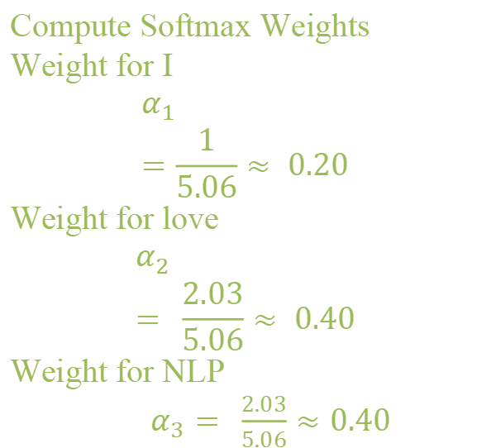
Step 6: Apply Softmax (Row-wise)
Compute Softmax Weights
For word “love” (2nd row):
[0, 0.71, 0.71]
exponentials: e⁰=1,e^{0.71}=2.03
Sums : 1+2.03+2.03=5.06
Softmax weights:
α=[0.20, 0.40, 0.40]
Compute Softmax Weights
Weight for I
$$α_{1}=\frac{1}{5.06}≈ 0.20$$
Weight for love
$$α_{2}= \frac{2.03}{5.06}≈ 0.40$$
Weight for NLP
$α_{3}= \frac{2.03}{5.06}≈0.40$

Slide 25
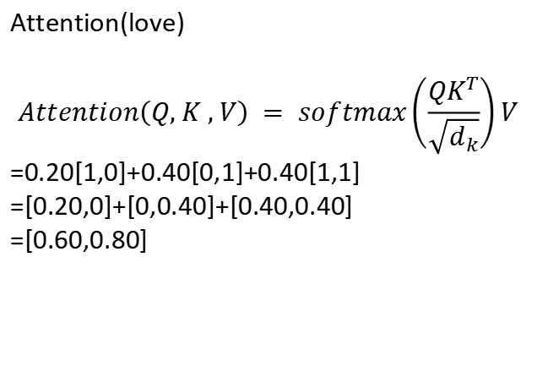
Step 7: Compute Attention Output
Step 8: Interpretation
Attention(love)
$$Attention\left(Q, K , V\right) = softmax\left(\frac{{QK}^{T}}{\sqrt{d_{k}}}\right)V$$
=0.20[1,0]+0.40[0,1]+0.40[1,1]
=[0.20,0]+[0,0.40]+[0.40,0.40]
=[0.60,0.80]
The word “love” attends:
20% to I
40% to love itself
40% to NLP
Hence, the representation of “love” now contains context from all words.

Slide 26
Multi-Headed Attention
Multi-Headed Attention improves the performance of the attention layer in two ways:
It expands the model’s ability to focus on different positions. Yes, in the example above, z1 contains a little bit of every other encoding, but it could be dominated by the actual word itself.
It gives the attention layer multiple representation subspaces.

Slide 27
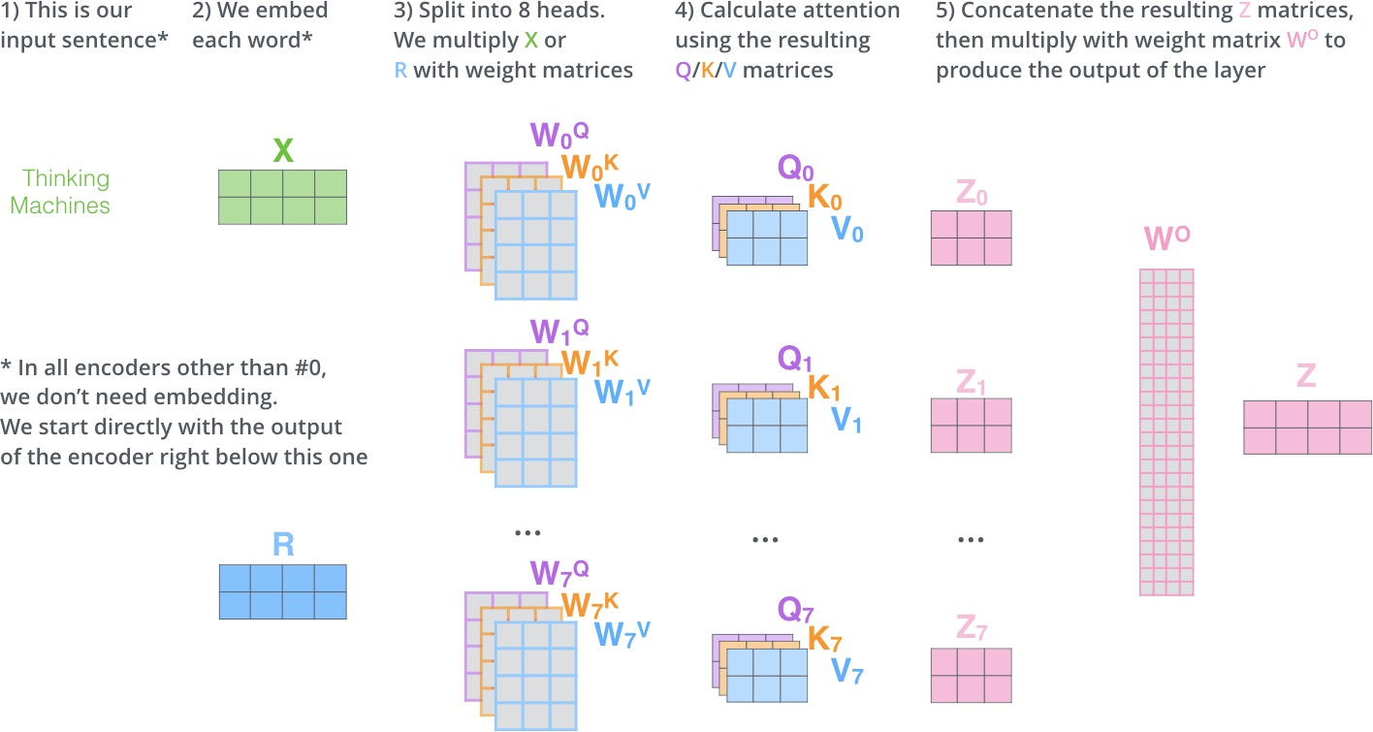
Multi-Headed Attention

Slide 28
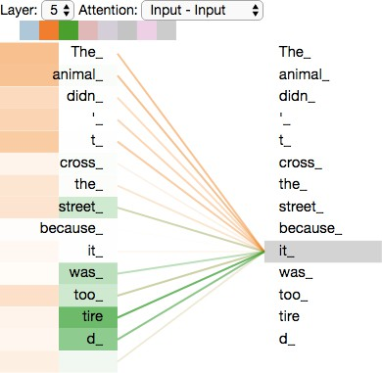
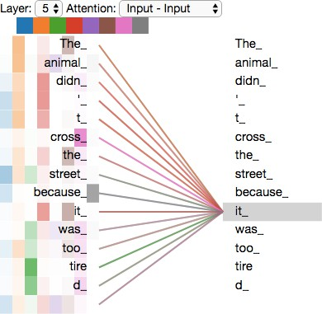
Multi-Headed Attention
As we encode the word "it", one attention head is focusing most on "the animal", while another is focusing on "tired" , in a sense, the model's representation of the word "it" bakes in some of the representation of both "animal" and "tired".
If we add all the attention heads to the picture, however, things can be harder to interpret.

Slide 29
Example (2 Heads)
Word Embedding
I [1, 0, 1, 0]
love [0, 2, 0, 2]
NLP [1, 1, 1, 1]
Let this be Q = K = V (self-attention).

Slide 30
example
2 tokens
2 heads
Different key dimensions
Head-1 → d_{k}=1
Head-2 → d_{k}=2
Queries, Keys, Values (1-D)
Step 1: Compute QK^{T}

Slide 31
Step2: Scale
Step 3: Softmax (row-wise)
Token-1 softmax(2,4) ≈ (0.12, 0.88)
Token-2 softmax(1,2) ≈ (0.27, 0.73)
Step 4: Multiply by V
Token-1
0.12(3)+0.88(4)=3.88
Token-2
0.27(3)+0.73(4)=3.73

Slide 32
Head-2 (dₖ = 2) Queries, Keys, Values (2-D)
Step 2: scale
Step 1: QK^{T}

Slide 33
Step 3: Softmax
Token-1 → [0.5, 0.5]
Token-2 → [0.67, 0.33]
Step 4: Multiply with V
Token-1
0.5[2,1]+0.5[1,3]=[1.5, 2]
Token-2
0.67[2,1]+0.33[1,3]=[1.67, 1.66]
Head-2 Output (dₖ = 2)

Slide 34
Transformers

Slide 35
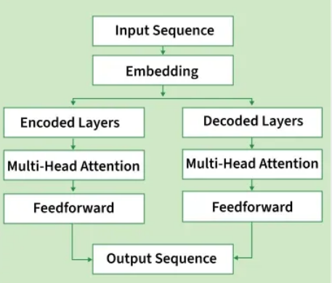
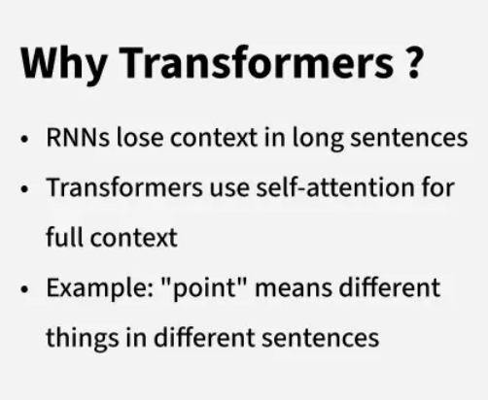
Transformers

Slide 36
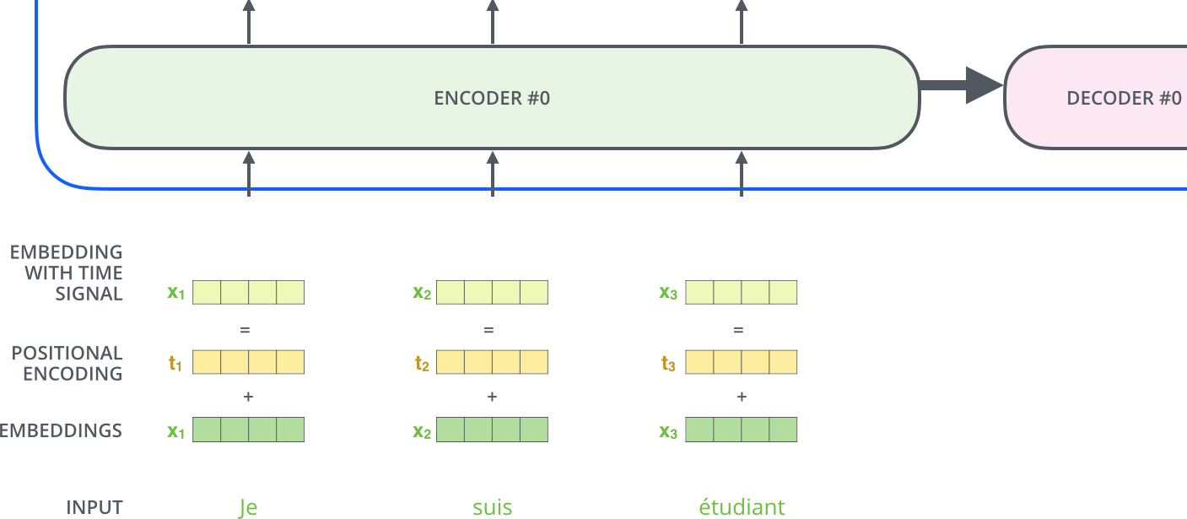
Transformer
Positional Encoding:
The transformer adds a vector to each input embedding. These vectors follow a specific pattern that the model learns, which helps it determine the position of each word or the distance between different words in the sequence.

Slide 37
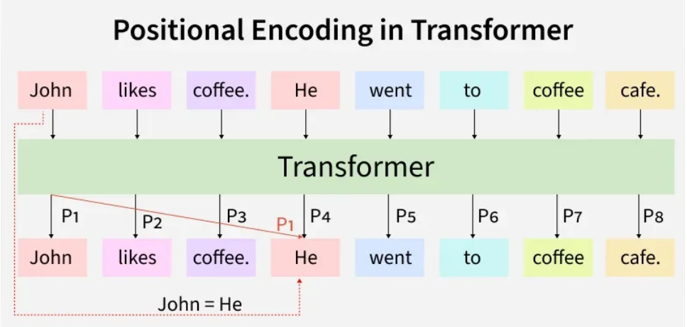

Slide 38
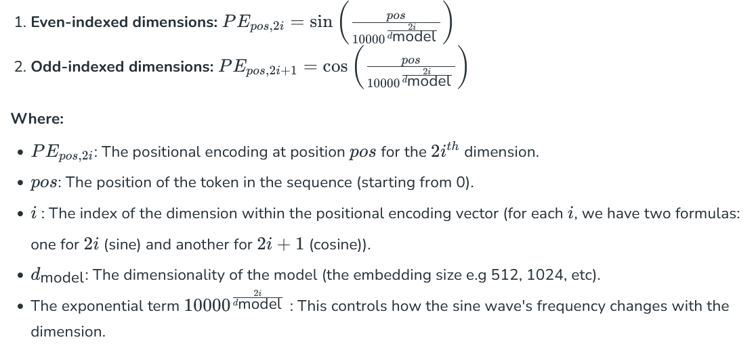
calculation of positional encoding
using sine and cosine functions provide a smooth, periodic encoding of positions that allows for easy interpolation and generalization across sequences of varying lengths.

Slide 39
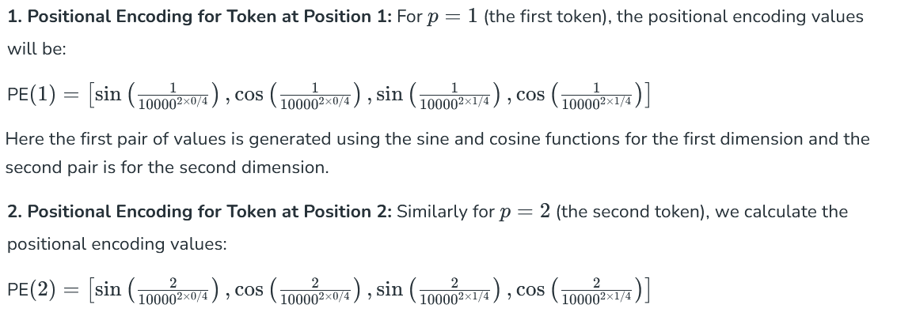
Example with Dimensionality

Slide 40
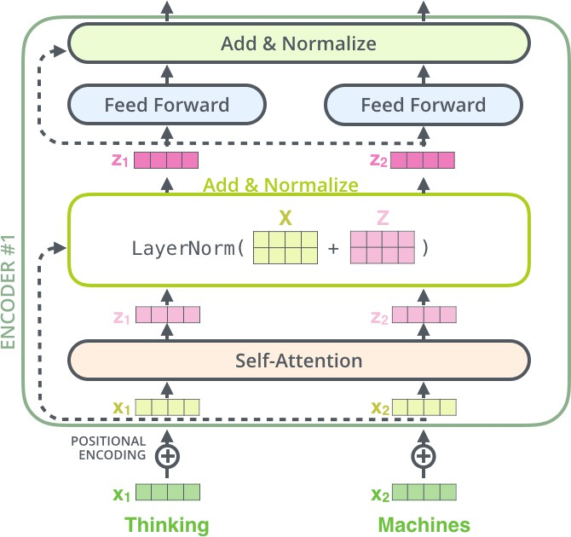
Transformer

Slide 41
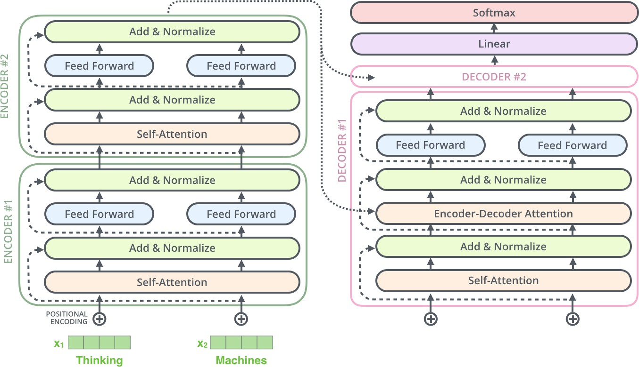
Transformer

Slide 42
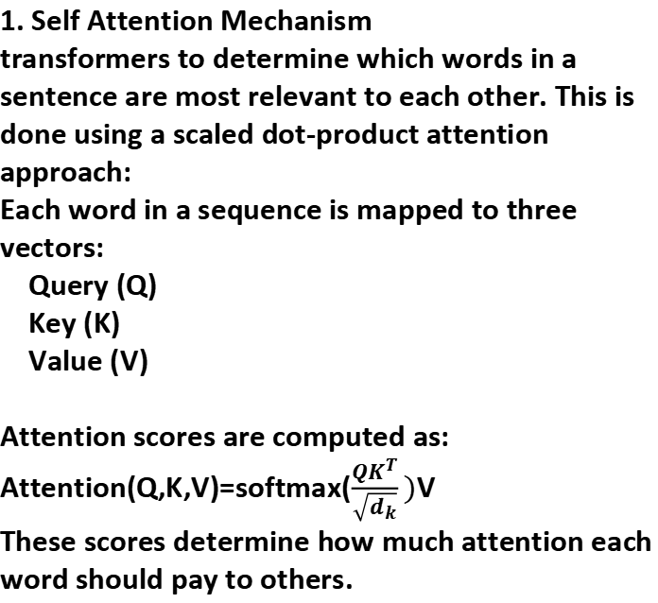
1. Self Attention Mechanism
transformers to determine which words in a sentence are most relevant to each other. This is done using a scaled dot-product attention approach:
Each word in a sequence is mapped to three vectors:
Query (Q)
Key (K)
Value (V)
Attention scores are computed as: Attention(Q,K,V)=softmax($\frac{QK^{T}}{\sqrt{d_{k}}})$V
These scores determine how much attention each word should pay to others.
2.Multi-Head Attention
Instead of one attention mechanism, transformers use multiple attention heads running in parallel. Each head captures different relationships or patterns in the data, enriching the model’s understanding.

Slide 43
3. Positional Encoding
Unlike RNNs, transformers lack an inherent understanding of word order since they process data in parallel.
To solve this problem Positional Encodings are added to token embeddings providing information about the position of each token within a sequence.
4. Position-wise Feed-Forward Networks
The Feed-Forward Networks consist of two linear transformations with a ReLU activation.
Mathematically:
FFN(x)=max(0,xW₁+b₁)W₂+b₂

Slide 44
5. Embeddings
each input token (word or subword) is converted into a vector, called an embedding.
Both encoder input tokens and decoder input tokens are converted into embeddings.
These embeddings are trainable, meaning the model learns the best numeric representation for each token.
The same weight matrix is shared for Encoder embeddings, Decoder embeddings and the final linear layer before softmax
The embeddings are scaled by model to keep values stable before adding positional encoding.
6. Encoder-Decoder Architecture
The encoder-decoder structure is key to transformer models. The encoder processes the input sequence into a vector, while the decoder converts this vector back into a sequence. Each encoder and decoder layer includes self-attention and feed-forward layers.

Slide 45
Encoder-Decoder Architecture
6.1. Encoder Self-Attention
Q, K, V all come from the encoder’s previous layer.
Every word can attend to every other word in the input.
This helps the encoder understand full context (long-range meaning).
6.2. Decoder Self-Attention (Masked)
Q, K, V all come from the decoder’s previous layer.
Future tokens are masked (blocked), so each position only sees previous tokens.
This keeps decoding auto-regressive i.e the model predicts one word at a time.

Slide 46
Encoder-Decoder Architecture
6.3.Encoder–Decoder Attention
Queries come from the decoder.
Keys and Values come from the encoder output.
This lets the decoder look at important parts of the input sentence while generating output.
These three attention types allow the transformer to read the entire input at once and then generate outputs step-by-step with full context.

Slide 47
7. Softmax Layer for Output Prediction
After the decoder processes the sequence, it must predict the next token.
The decoder output is passed through a linear layer (whose weights are shared with embeddings).
Then the softmax function converts these scores into probabilities.
The token with the highest probability becomes the predicted next word.
For instance in the sentence "The cat didn't chase the mouse, because it was not hungry" the word 'it' refers to 'cat'. The self-attention mechanism helps the model correctly associate 'it' with 'cat' ensuring an accurate understanding of sentence structure.

Slide 48
Eaxmple 1
Worked Transformer Example (Encoder Self-Attention)
Step 1: word embedding
eg: “EV cars evolve”
Assumptions (kept small for clarity):
Sequence length = 3
Model dimension d_{model}=4
Number of heads = 1
Key dimension d_{k}=2
Token | Embedding
EV | [1, 2, 0, 1]
cars | [0, 1, 2, 1]
evolve | [1, 1, 1, 2]

Slide 49
Step 2: Positional encoding
Step 3: Query, Key, Value Projection
Position | PE
1 | [0.1, 0.1, 0.1, 0.1]
2 | [0.2, 0.2, 0.2, 0.2]
3 | [0.3, 0.3, 0.3, 0.3]

Slide 50
Step 2: Positional encoding
Step 3: Query, Key, Value Projection
Position | PE
1 | [0.1, 0.1, 0.1, 0.1]
2 | [0.2, 0.2, 0.2, 0.2]
3 | [0.3, 0.3, 0.3, 0.3]

Slide 51
Step 4: Scaled Dot-Product Attention
Dot product QK^{T}
Scaling

Slide 52
Softmax (row-wise)
Step 5: Attention Output
Output=A×V

Slide 53
Step 6: add and layer normalization
Final=LayerNorm(X′+Output)
Step 7: feed-forward network
FFN(x)=max(0,xW_{1​}+b_{1​})W_{2​}+b_{2​}
Applied independently to each token
Adds non-linearity and expressive power

Slide 54
Masked multi-head attention in transformer

Slide 55
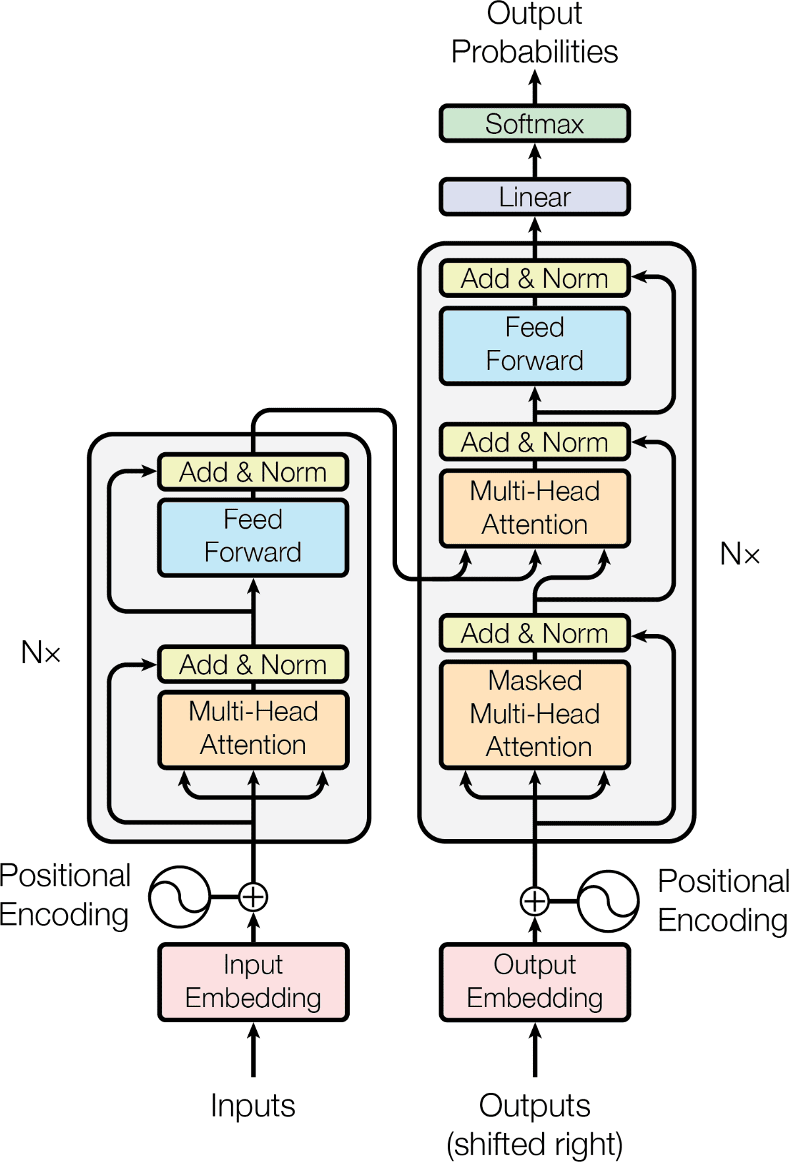
Transformer
Attention Is All You Need
https://arxiv.org/abs/1706.03762

Slide 56
Masked multi-head attention
decoder of Transformer models, especially for sequence generation tasks like machine translation, text summarization, and language modeling.

Slide 57
Need
In autoregressive generation, the model must not look into the future.
When predicting a token at position t, the decoder should only use:
tokens at positions ≤ t
not tokens at positions > t (future words)
Without masking, self-attention would allow every token to attend to all positions, including future tokens → data leakage.

Slide 58
A look-ahead (causal) mask is applied to the attention score matrix before softmax.
-∞ ensures softmax assigns zero probability
Tokens can attend only to previous and current positions

Slide 59
Multi-Head + Masking
Different Heads Learn Different Dependencies
Each head focuses on different aspects:
Head 1 → short-range syntax
Head 2 → long-range semantics
Head 3 → positional relationships
Masking is applied independently to every head, ensuring:
No head violates causality
Rich representations without cheating
Parallel Training With Causality Preserved
RNNs enforce causality sequentially (slow).
Masked attention enforces causality mathematically, allowing:
Parallel computation
Correct autoregressive behavior

Slide 60
Summary
Sentence to generate:
“I love deep learning”
While predicting “love”:
Allowed to see: I
Not allowed to see: deep learning
Masked attention enforces this strict information flow.
Masked multi-head attention prevents future information leakage
Used in decoder self-attention only
Enables parallel training with autoregressive constraint
Maintains causal language modeling
Each head learns different dependencies without violating causality

Slide 61
Masked Self-Attention (Transformer Decoder)
“EV cars evolve”
Step 2; Unmasked attention scores
Step 1: Assume 2-D vectors (after embedding + positional encoding):
Dot-product scores QK^{T}
Token | Vector
EV | [1, 0]
cars | [0, 2]
evolve | [1, 1]
Scaling ($√2$≈1.41)
Q=K=V=X

Slide 62
Step 3: Look-ahead (causal) mask
Step 5 :Softmax (row-wise)
Row 1 (EV)
softmax([0.71,−∞,−∞])=[1,0,0]
Row 2 (cars)
softmax([0,2.83,−∞])≈[0.06,0.94,0]
Row 3 (evolve)
softmax([0.71,1.41,1.41])≈[0.20,0.40,0.40]
Apply triangular mask
Step 4: Apply mask to scores

Slide 63
Step 6 : Masked attention matrix
Step 7: Final attention output
Output=A×V
EV =[1,0]
cars =0.06[1,0]+0.94[0,2]=[0.06, 1.88]
evolve =0.20[1,0]+0.40[0,2]+0.40[1,1]=[0.60, 1.20]

Slide 64
Difference: Masked vs Unmasked
Token | Unmasked can see | Masked can see
EV | EV, cars, evolve | EV only
cars | EV, cars, evolve | EV, cars
evolve | EV, cars, evolve | EV, cars, evolve
Masked self-attention prevents a decoder token from attending to future tokens by assigning −∞ to future positions before softmax.

Slide 65
Transformer
The Annotated Transformer
a line-by-line implementation
http://nlp.seas.harvard.edu/annotated-transformer/

Slide 66
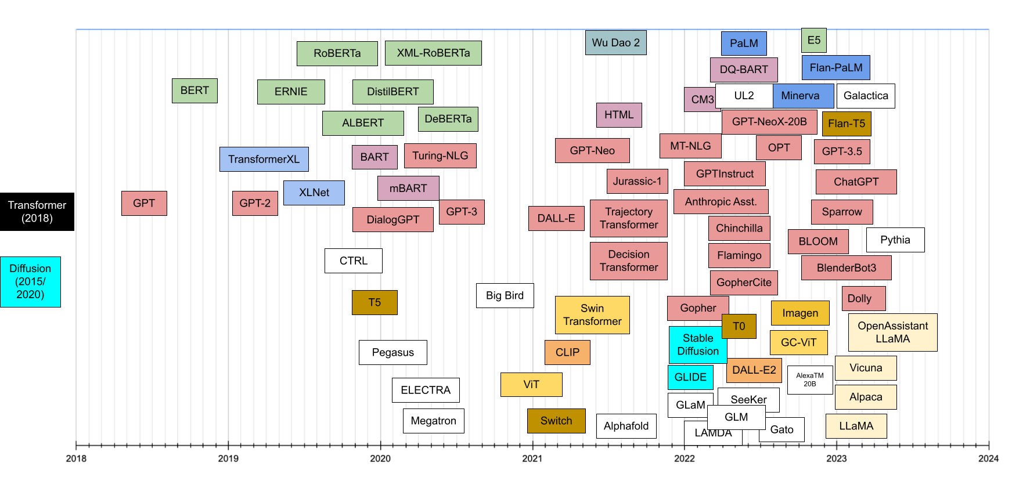
Transformer

Slide 67
Annotated Transformer
Not a different model, but a step-by-step, labeled (annotated) explanation of the standard Transformer architecture, where each sub-component is explicitly shown, named, and explained with its purpose and computations.

Slide 68
Example: “Students learn transformers”
Step 1: Input Sentence (Encoder)
Step 2: Embedding + Positional Encoding
Tokens:
t1 = Students
t2 = learn
t3 = transformers
Assume:
Model dimension: d_model = 4
Positional encoding already added
Each row = one token

Slide 69
Step 3: Multi-Head Self-Attention (Encoder)
Compute Q, K, V (Head-1)
use:
2 heads
d_{k}=2 per head
Total d_{model}=4
Head-1 Parameters
Attention Scores (Scaled Dot Product)

Slide 70
Softmax (Row-wise)
Head-2 (Different Projection)
Z⁽¹⁾=softmax.V

Slide 71
Step 4: Concatenate Heads
Z= [Z¹||Z²]

Slide 72
Vision Transformer (ViT)

Slide 73
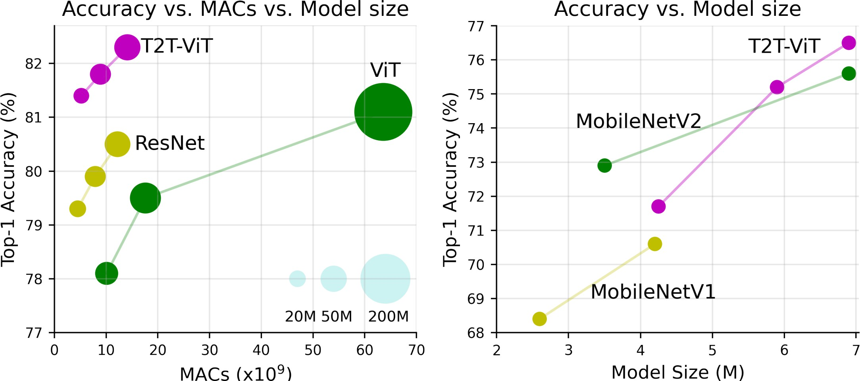
Vision Transformers (ViTs) vs CNNs
Performance benchmark comparison of Vision Transformers (ViT) with ResNet and MobileNet when trained from scratch on ImageNet.

Slide 74
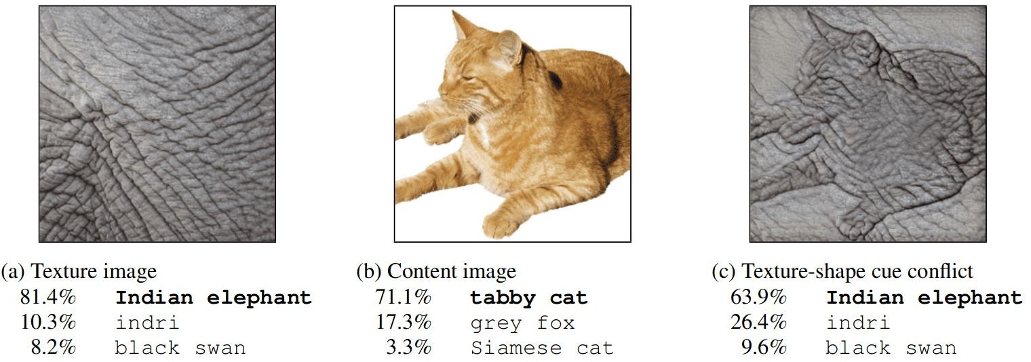
Vision Transformers (ViTs) vs CNNs
The authors in [1] demonstrated that CNNs trained on ImageNet are strongly biased towards recognizing textures rather than shapes. Below is an excellent example of such a case:
[1]: ImageNet-trained CNNs are biased towards texture; increasing shape bias improves accuracy and robustness. https://arxiv.org/abs/1811.12231

Slide 75
Vision Transformers (ViTs) vs CNNs
Neuroscience studies (The importance of shape in early lexical learning [1]) showed that object shape is the single most important cue for human object recognition.
By studying the visual pathway of humans regarding image recognition, researchers identified that the perception of object shape is invariant to most perturbations. So as far as we know, the shape is the most reliable cue.
Intuitively, the object shape remains relatively stable, while other cues can be easily distorted by all sorts of noise [2].
1: https://psycnet.apa.org/doi/10.1016/0885-2014(88)90014-7
2: https://arxiv.org/abs/1811.12231
42

Slide 76
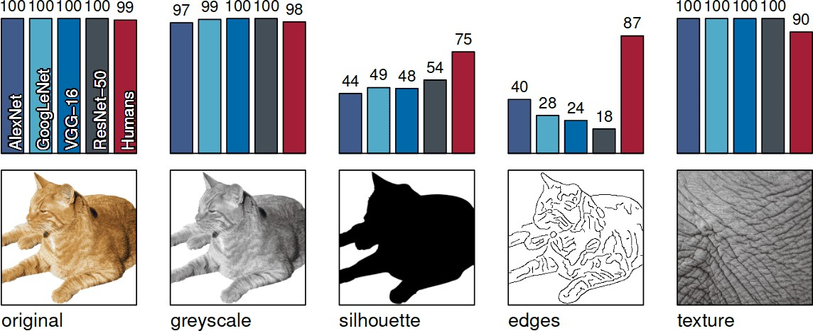
Vision Transformers (ViTs) vs CNNs
Accuracies and example stimuli for five different experiments without cue conflict.
Source: https://arxiv.org/abs/1811.12231

Slide 77
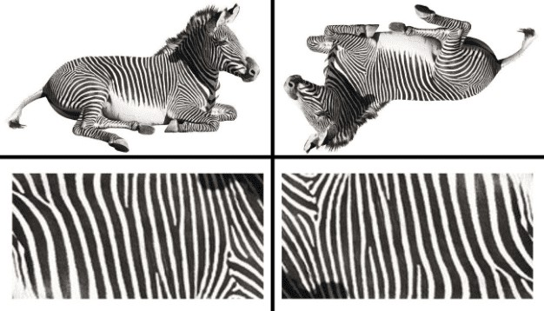
Vision Transformers (ViTs) vs CNNs
The texture is not sufficient for determining whether the zebra is rotated. Thus, predicting rotation requires modeling shape, to some extent.
The object's shape can be invariant to rotations.

Slide 78
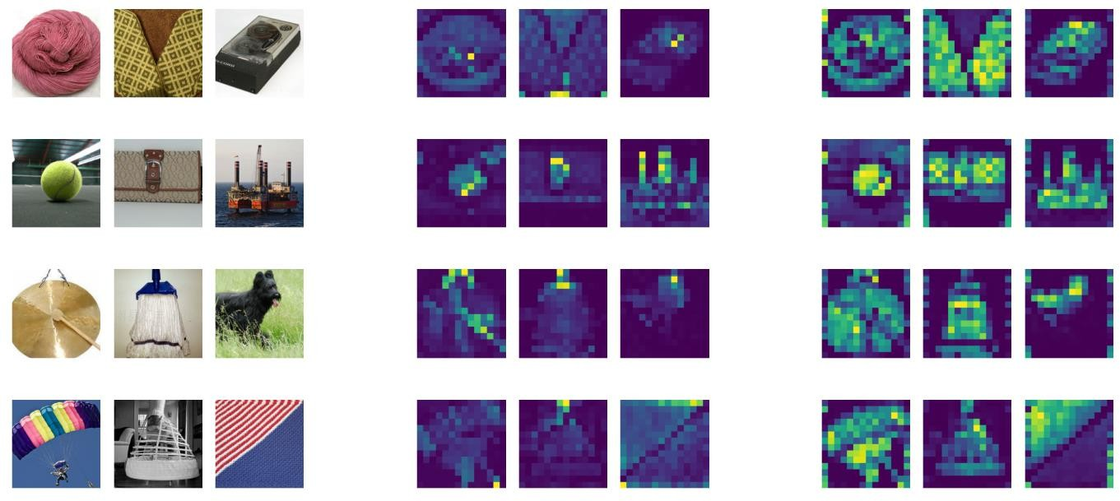
Vision Transformers (ViTs) vs CNNs
The self-attention captures long-range dependencies and contextual information in the input data.
The self-attention mechanism allows a ViT model to attend to different regions of the input data based on their relevance to the task at hand.
Raw images (Left) and attention maps of ViT-S/16 with (Right) and without (Middle).
https://arxiv.org/abs/2106.01548

Slide 79
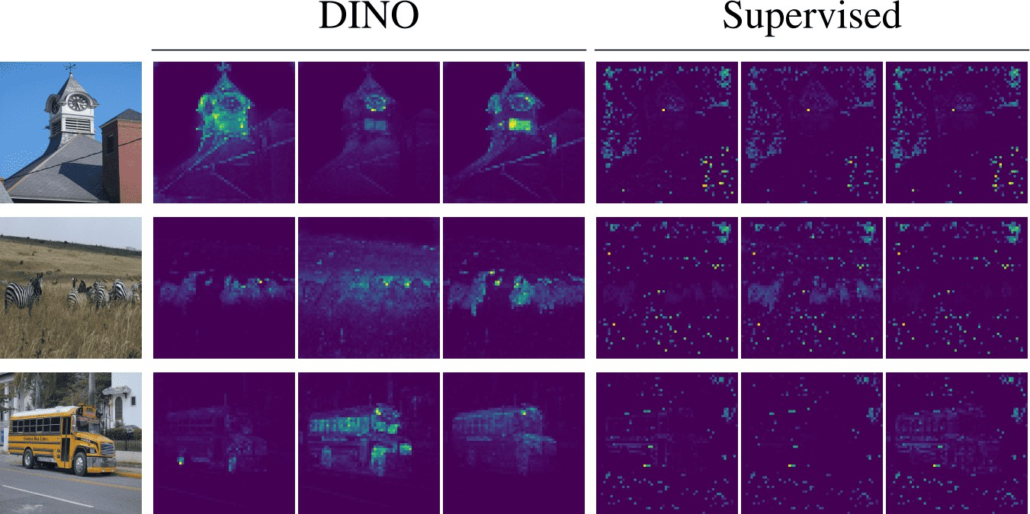
Vision Transformers (ViTs) vs CNNs
The authors in [1] looked at the self-attention of the CLS token on the heads of the last layer. Crucially, no labels are used during the self-supervised training. These maps demonstrate that the learned class-specific features lead to remarkable unsupervised segmentation masks and visibly correlate with the shape of semantic objects in the images.
1: Self-Supervised Vision Transformers with DINO https://arxiv.org/abs/2104.14294

Slide 80
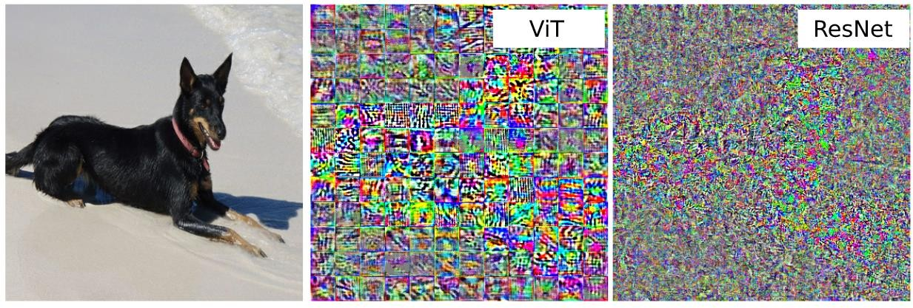
Vision Transformers (ViTs) vs CNNs
The adversarial perturbations computed for a ViT and a ResNet model.
The adversarial perturbations are qualitatively very different even though both models may
perform similarly in image recognition.
ViTs and ResNets process their inputs very differently. https://arxiv.org/abs/2103.14586

Slide 81
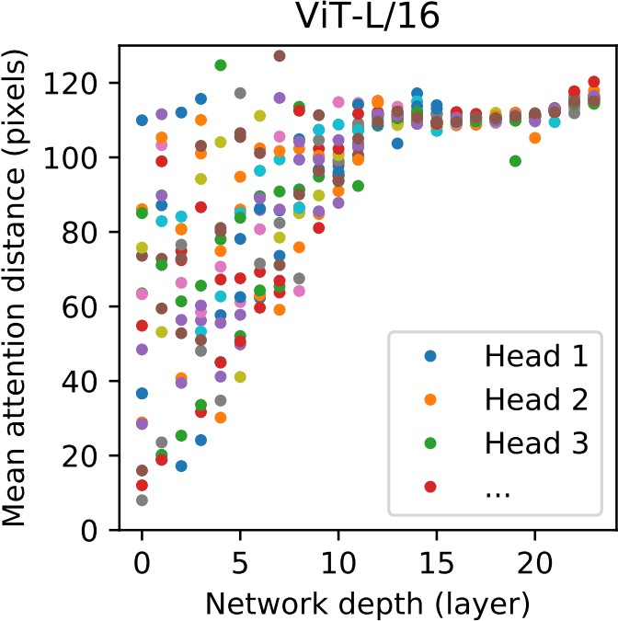
Vision Transformers (ViTs) vs CNNs
The transformer can attend to all the tokens (image patches) at each block by design. The originally proposed ViT model in [1] already demonstrated that heads from early layers tend to attend to far-away pixels, while heads from later layers do not.
How heads of different layers attend to their surrounding pixels [1].
[1]: https://arxiv.org/abs/2010.11929

Slide 82
Vision Transformers (ViTs)
How the Vision Transformer Works:
Split an image into patches
Flatten the patches
Produce lower-dimensional linear embeddings from the flattened patches
Add positional embeddings
Feed the sequence as an input to a standard transformer encoder
Pretrain the model with image labels (fully supervised on a huge dataset)
Finetune on the downstream dataset for image classification

Slide 83
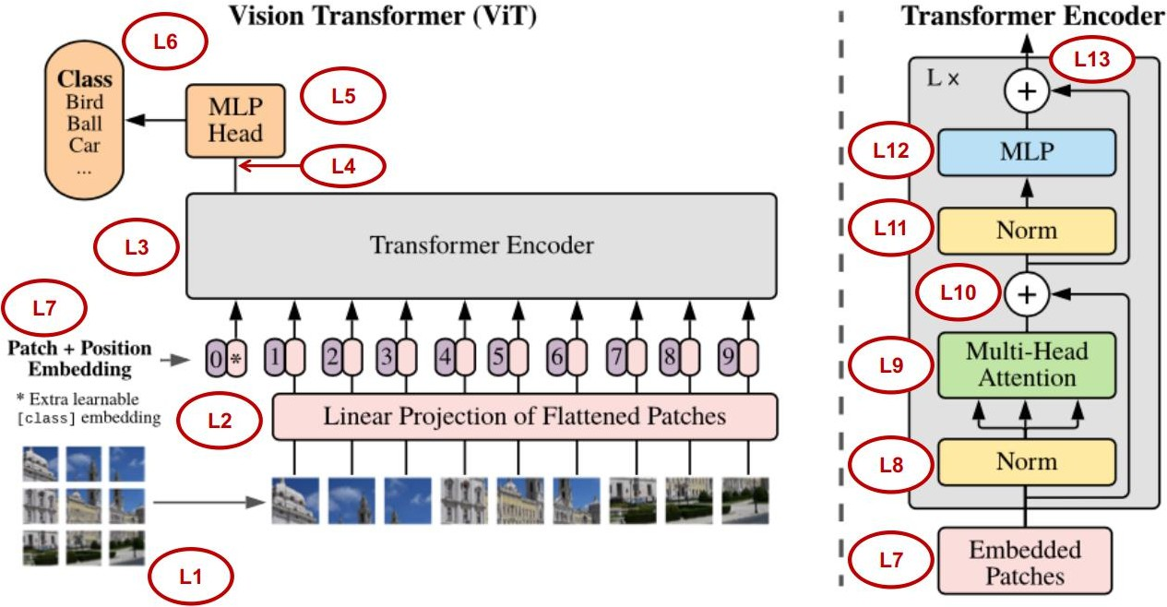
Vision Transformers (ViTs)
https://github.com/hichemfelouat/my-codes-of-machine-learning/blob/master/Vision_Transformer_(ViT)_for_Image_Classification_(cifar10_dataset).ipynb

Slide 84
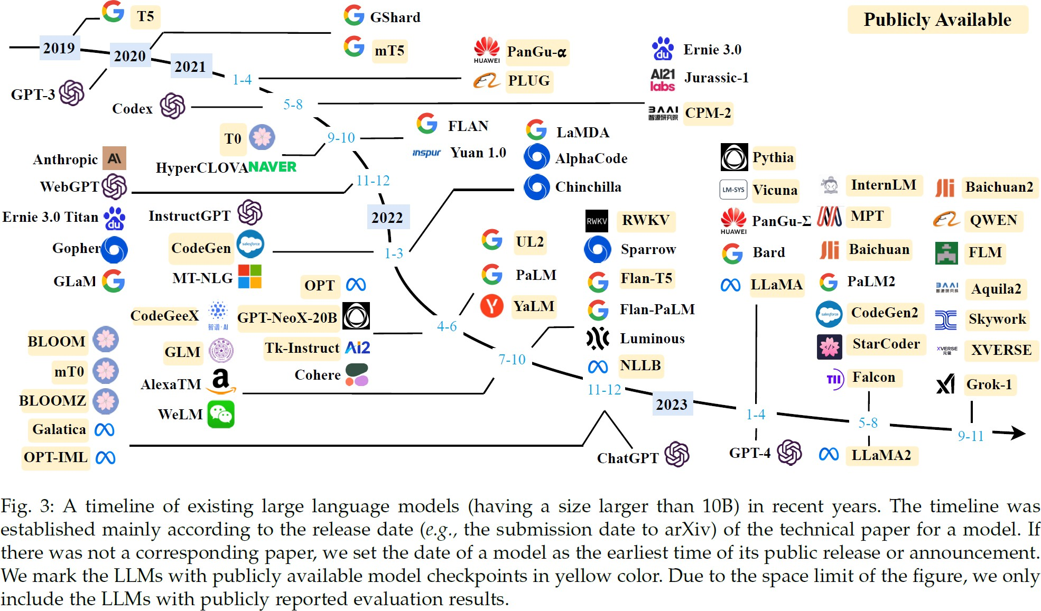
Large Language Models
A Survey of Large Language Models:
https://arxiv.org/abs/2303.18223
52

Slide 85
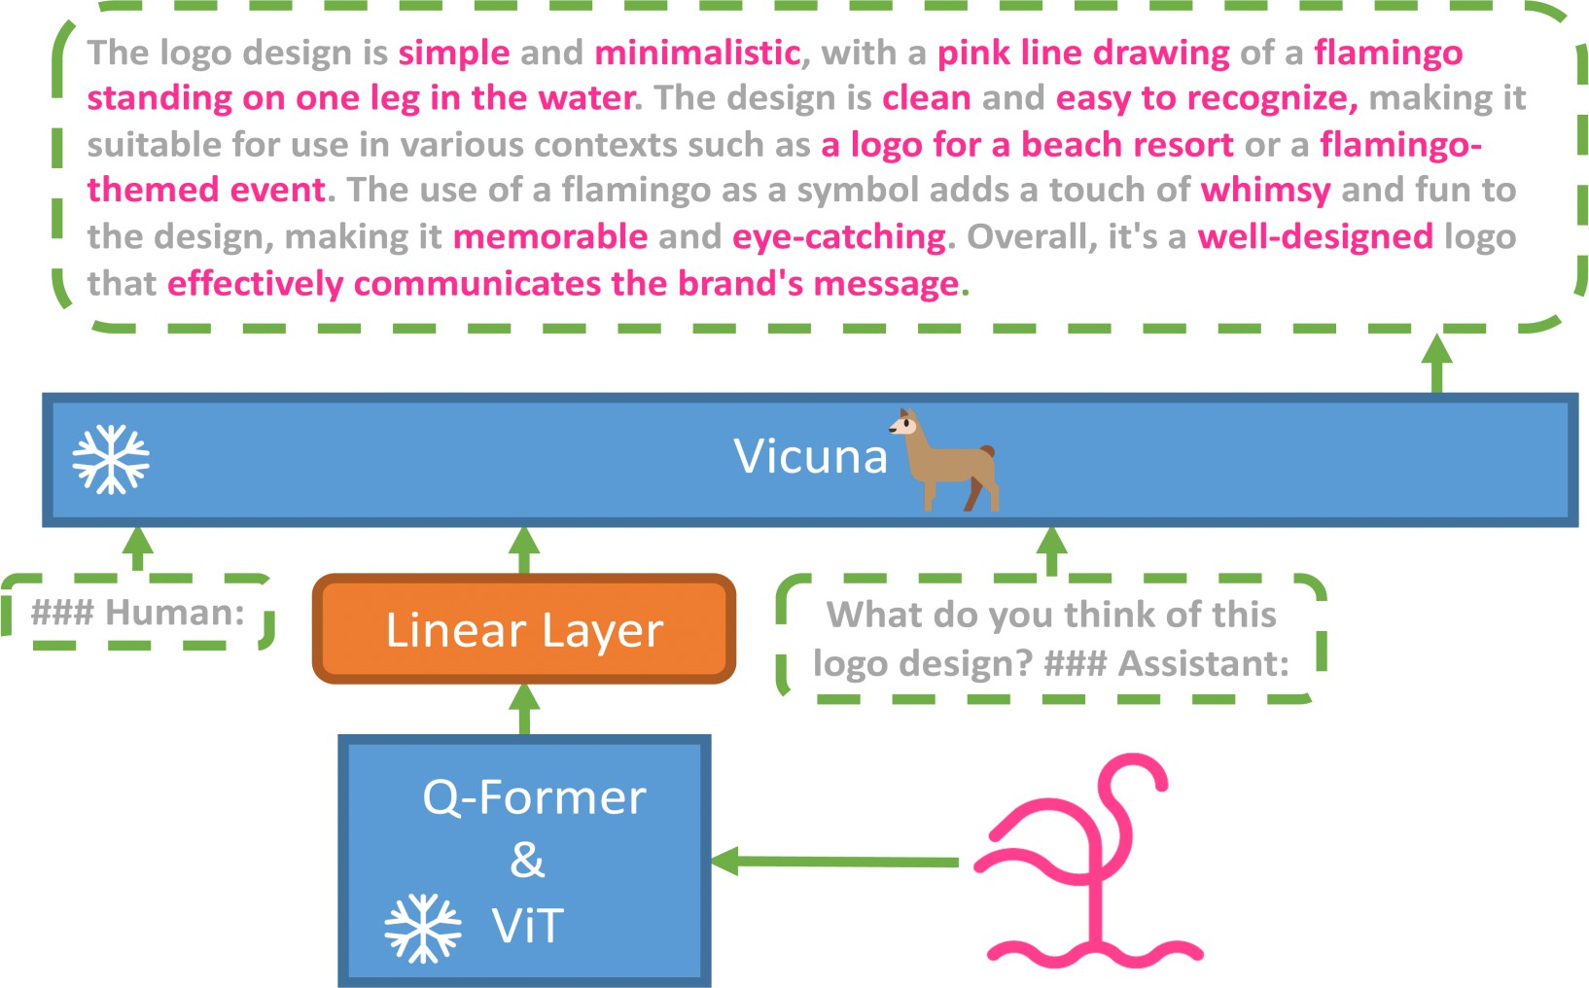
Vision Language Models
The architecture of MiniGPT-4
https://minigpt-4.github.io

Slide 86

Vision Language Models
https://github.com/Vision-CAIR/MiniGPT-4

